Slide 1
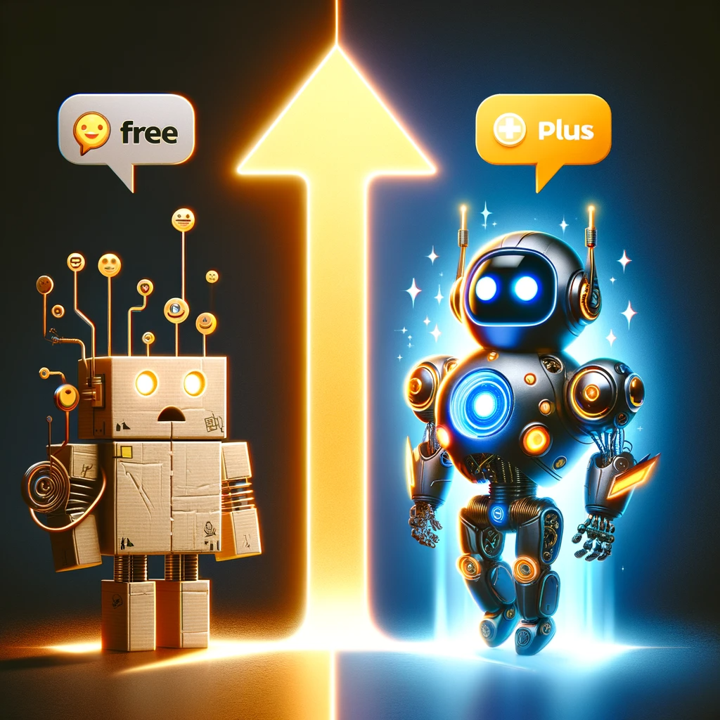
Why You Should Upgrade from ChatGPT Free to ChatGPT Plus
Universal Knowledge for the Price of
some burgers and fries
Notes:
https://careerservices.upenn.edu/preparing-effective-resumes/undergraduates-student-resume-samples/

Slide 2
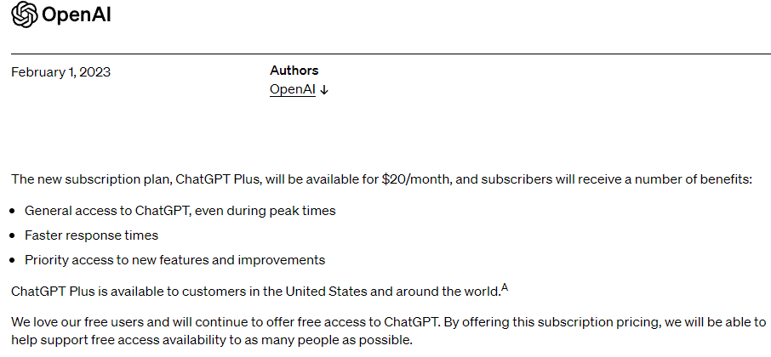
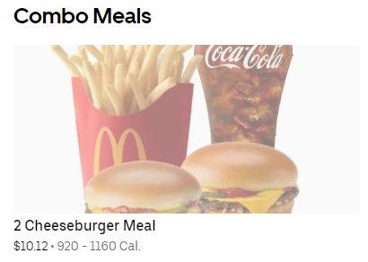

Slide 3
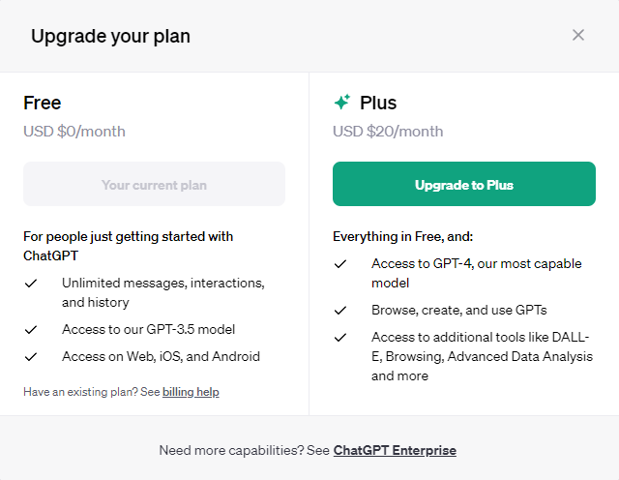
Upgrading to ChatGPT Plus

Slide 4
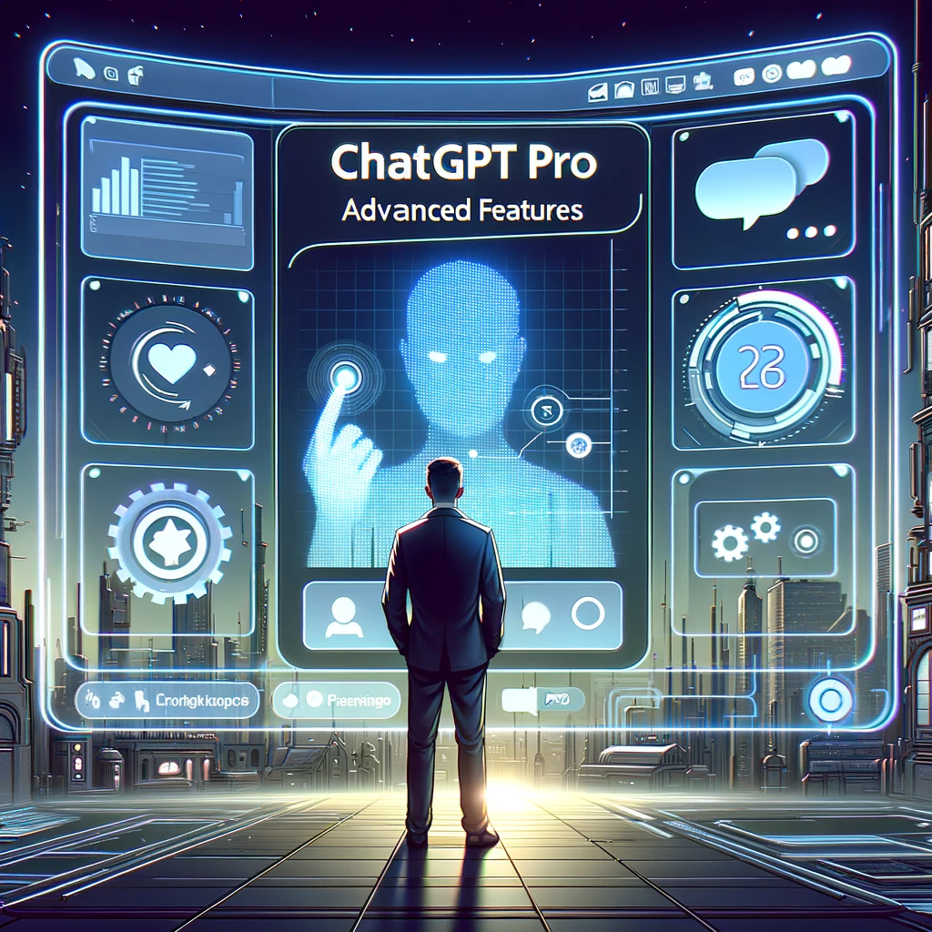
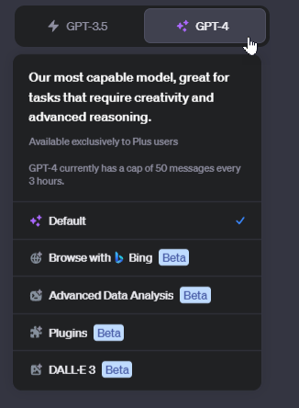
Why Use Chat GPT Plus?
Notes:
https://openai.com/blog/chatgpt-plus

Slide 5
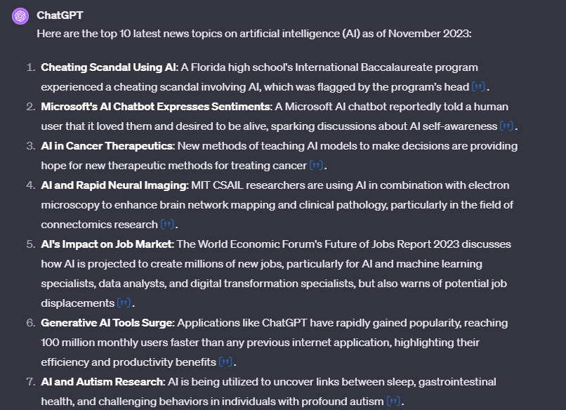
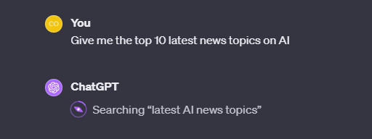
Browse with Bing

Slide 6
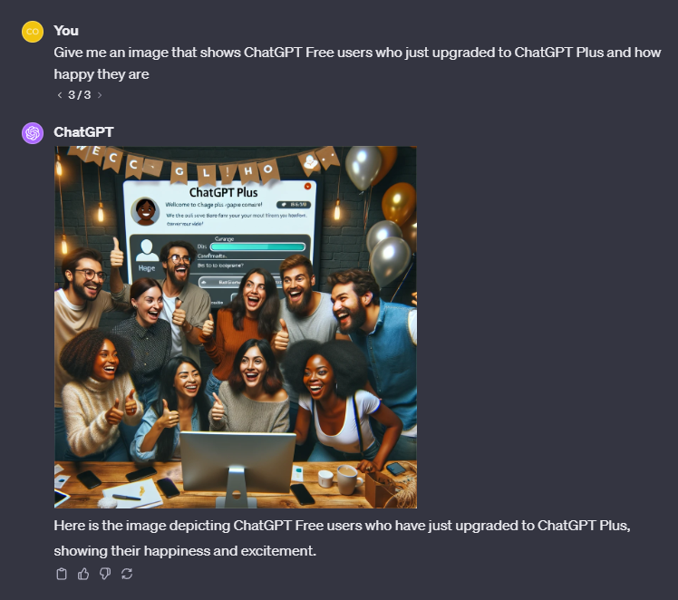
Dall-E 3: Generative Images

Slide 7
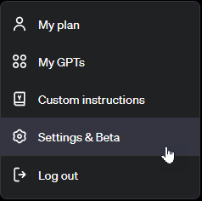
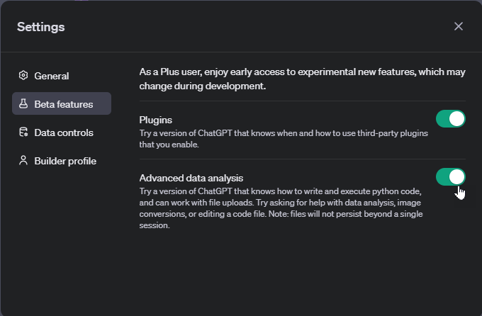
Features You need to Turn on

Slide 8
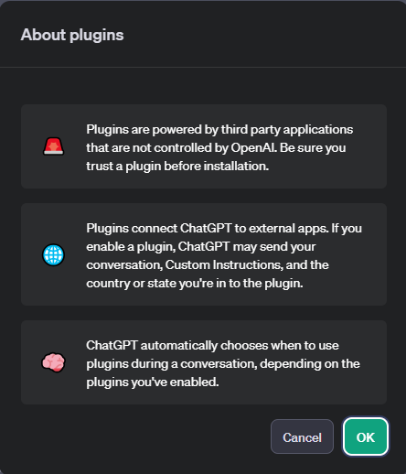
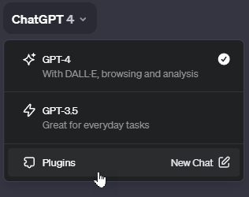
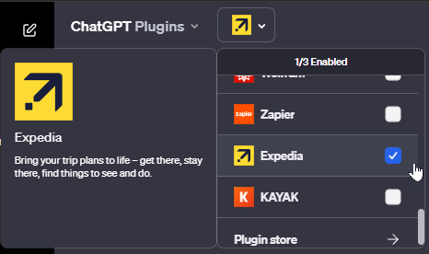
Plugins

Slide 9
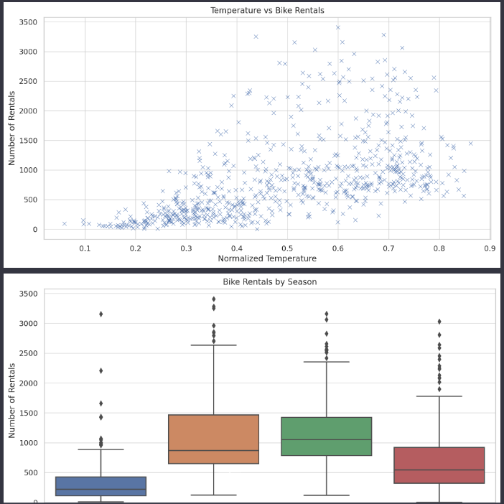
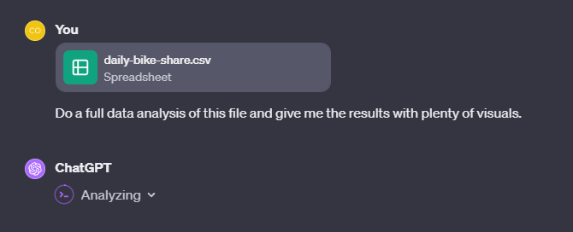
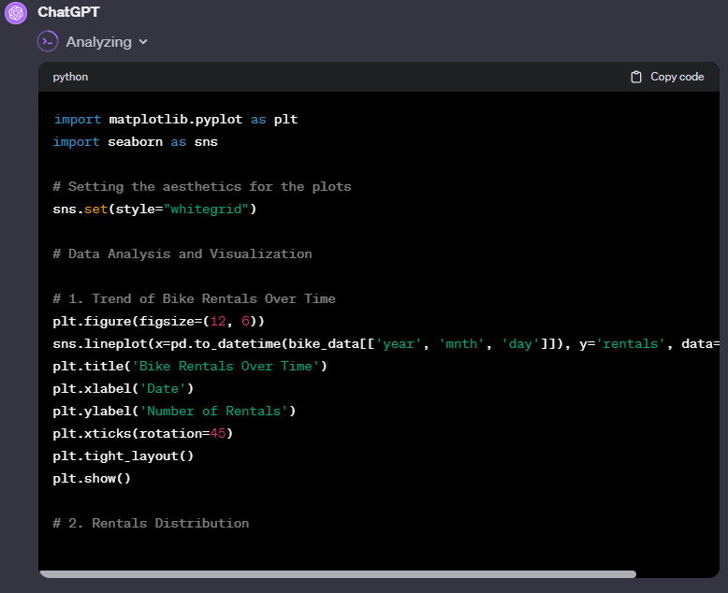
Advanced Data Analysis

Slide 10
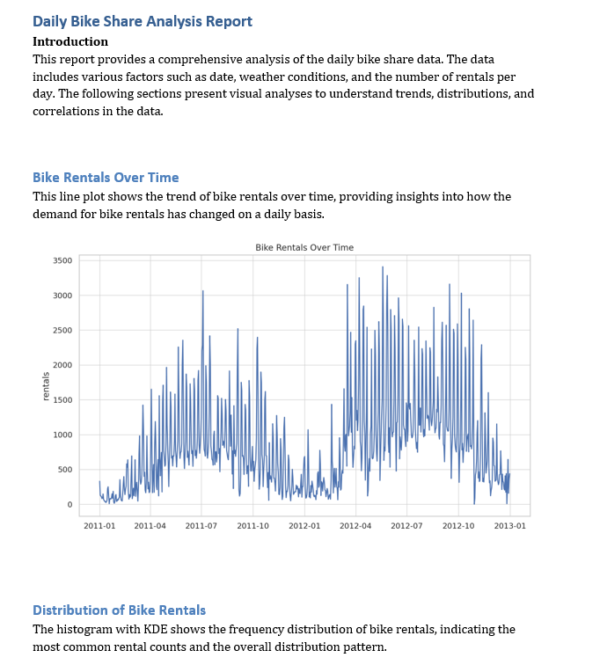
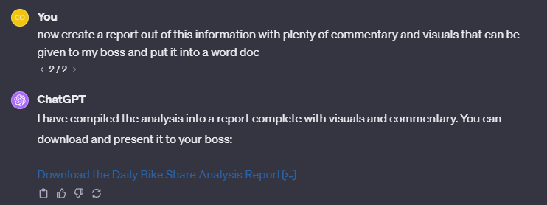
Advanced Data Analysis

Slide 11
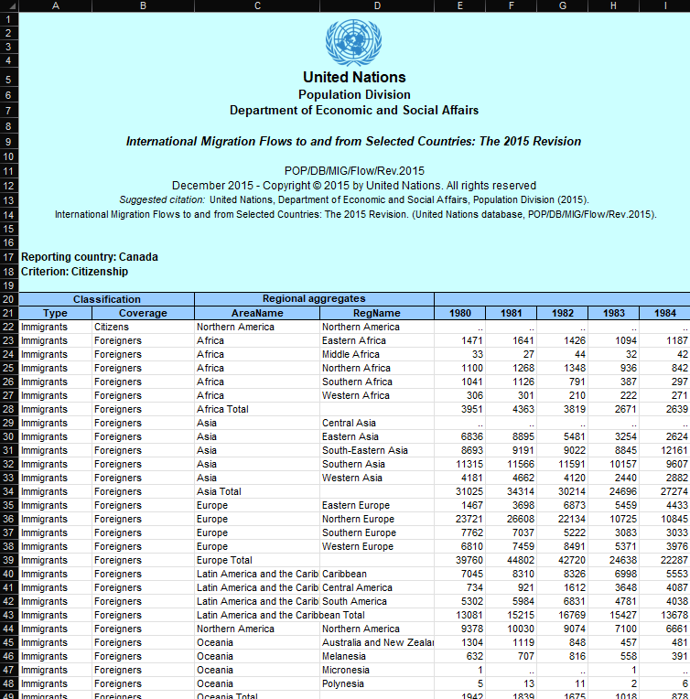
Data Analysis Canada Migration Demo

Slide 12
Use the website, Get the mobile App
Website - https://chat.openai.com/
Mobile
Android - https://play.google.com/store/apps/details?id=com.openai.chatgpt&hl=en_US&gl=US&pli=1
iPhone - https://apps.apple.com/us/app/chatgpt/id6448311069

